Slide 1
GIAPI Data Service (GDS)Design Review
Carlos Quiroz, Nicolás A. Barriga, Arturo Nuñez

Slide 2
GDS Motivation
GIAPI specifies a different way to create science FITS files
Aims to reduce or eliminate the dependency on DHS
DHS seen as unstable and difficult to maintain
GDS is decoupled from the instrument

Slide 3
Overview
GIAPI-based instruments write standard FITS files with a basic set of keywords
Instrument fires observation events at given times
GDS collects FITS keyword values from observatory systems (OCS, TCS) and instrument status
GDS accepts FITS keyword values from external systems that cannot be queried like Seqexec
GDS adds keywords to FITS files

Slide 4
Observation Event Driven Data Collection
Instrument publishes the following observation events
GIAPI Observation Event | Description
OBS_PREP | Before anything is collected
OBS_START_ACQ | Start of acquisition
OBS_END_ACQ | End of acquisition
OBS_START_READOUT
OBS_END_READOUT
OBS_START_DSET_WRITE | Start writing FITS file
OBS_END_DSET_WRITE | FITS file ready

Slide 5
GDS Interactions

Slide 6
Configuration
#
# Sample of GDS configuration
#
#
# Instrument Event Keyword Name FITS Data Gemini Default Source Subsystem Array Comment
# Name in FITS Header Type Mandatory Value channel Index
# ----------- ------------- --------------- ------- ------- --------------- ------- ----------- ------------------------- ------- -----------------
#
GPI OBS_END_ACQ AIRMASS 0 DOUBLE F NONE EPICS ws:massAirmass 0 "Mean airmass for the observation"
GPI OBS_END_ACQ AMEND 0 DOUBLE F NONE EPICS ws:massAirmass 1 "Airmass at end of exposure"
GPI OBS_START_ACQ AMSTART 0 DOUBLE F NONE EPICS ws:massAirmass 2 "Airmass at start of exposure"
GPI OBS_END_ACQ HUMIDITY 0 DOUBLE F NONE EPICS ws:cpHumid 0 "The relative humidity (fraction, 0..101)."
GPI OBS_END_ACQ TAMBIENT 0 DOUBLE F NONE EPICS ws:cpTemp50m 0 "The ambient temp (C)."
GPI OBS_END_ACQ TAMBIEN2 0 DOUBLE F NONE EPICS ws:cpTemp50m 0 "The ambient temp (F)."
GPI OBS_END_ACQ PRESSURE 0 DOUBLE F NONE EPICS ws:cpPress 0 "The atmospheric pressure (mm Hg)."
GPI OBS_START_ACQ PRESSUR2 0 DOUBLE F NONE EPICS ws:cpPress 0 "The atmospheric pressure (Pa)."
GPI OBS_START_ACQ DEWPOINT 0 DOUBLE F NONE EPICS ws:wsDew 0 "The dew point (C)."
GPI OBS_START_ACQ WINDSPEE 0 DOUBLE F NONE EPICS ws:cpWindSpeed 0 "The wind speed (m/s)."
GPI OBS_START_ACQ WINDDIRE 0 DOUBLE F NONE EPICS ws:cpWindDir 0 "The wind direction (degrees)."
GPI OBS_START_ACQ GPIST1 0 DOUBLE F NONE STATUS gpi:status1 0 "GPI generated status 1"
GPI OBS_END_ACQ GPIST2 0 DOUBLE F NONE STATUS gpi:status2 0 "GPI generated status 2"
GPI OBS_PREP GPISEQ 0 DOUBLE F NONE SEQEXEC gpi:seqexec 0 "Seqexec provided value"
GPI OBS_PREP PIFSTNAM 0 DOUBLE F NONE ODB odb:piFirstName 0 "PI's first name"

Slide 7
Observation Sequence

Slide 8
Starting an Observation

Slide 9
Starting an Observation
User signals an observation on Seqexec
Seqexec obtains a DataLabel for the observation
Seqexec sends to GDS the DataLabel and Program ID
Seqexec may also send FITS keywords for the current observation to GDS
Seqexec sends an Observe Sequence Command to the instrument with the DataLabel

Slide 10
FITS Keywords Composition

Slide 11
FITS Keywords Composition
GDS listens to Observation Events while the Instrument executes an observation
GDS collects FITS keywords on certain events

Slide 12
Completion of FITS Files

Slide 13
Completion of FITS Files
Instrument writes base FITS to GDSN
GDS completes the full set of FITS keywords to the FITS file
Original files are preserved

Slide 14
DataLabel Generation

Slide 15
DataLabel generation
Seqexec still needs data labels for GIAPI
Shouldn’t break existing instruments or data processing
Alternatives:
Keep current setup using DHS giving DataLabels that will not be populated
Extract common DataLabel Generator Component from DHS
Use independent DataLabel naming convention

Slide 16
Current setup

Slide 17
Extraction of common DataLabel generator

Slide 18
Independent naming

Slide 19
User Interface

Slide 20
User Interface
Observations are triggered form Seqexec
Web-based interface for configuration and status check

Slide 21
Keyword configuration in edit mode

Slide 22
Keyword configuration in read-only mode

Slide 23
System configuration

Slide 24
GDS Status

Slide 25
GDS Log

Slide 26
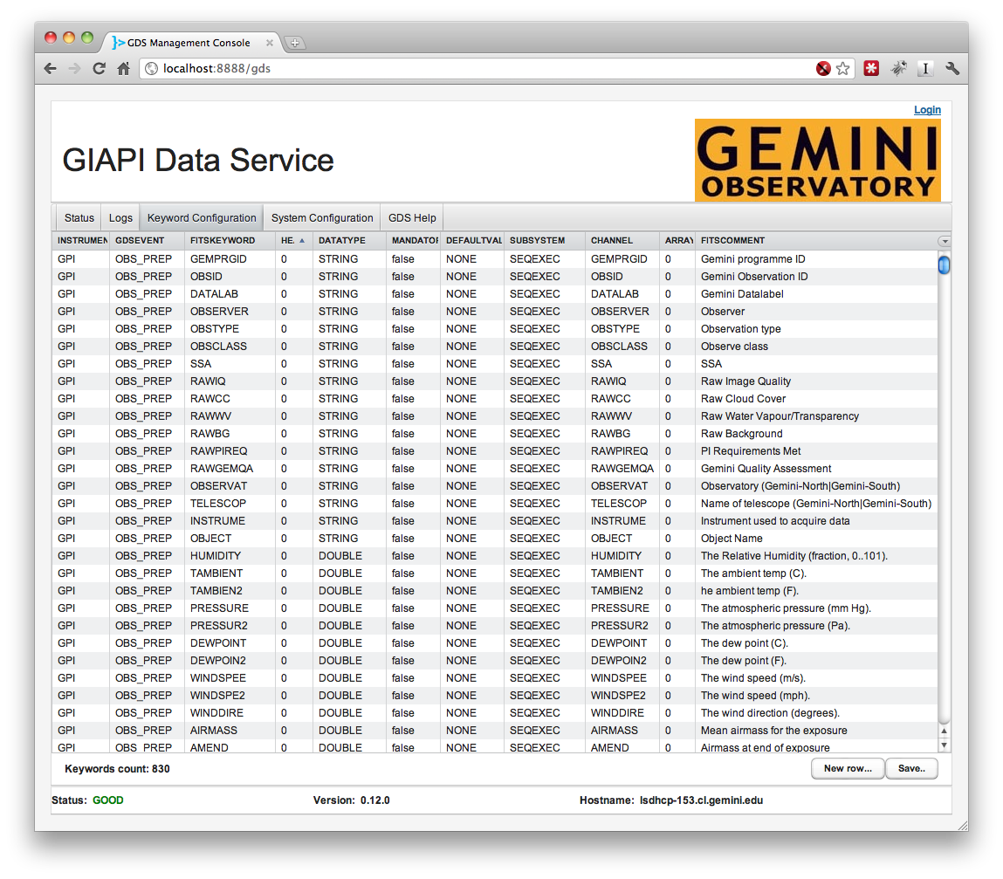
Current version

Slide 27
Operational Aspects
Runs with GMP
Heartbeat and status
Logging as usual

Slide 28
Demo
Demo
Questions?

Slide 29
Protocols
EPICS
JMS
XMLRPC
Jini/RMI

Slide 30
Scala
Compiles to bytecode, runs on a standard JVM and transparently interoperates with Java.
Statically typed combined with a type inference mechanism.
Combination of functional and object-oriented paradigms.
The actor concurrency model provides a safe way to build concurrent applications that scale easily.

Slide 31
Observation Sequence in Detail

